Slide 1
SCOUTING AMERICA
Golden Gate Area Council
Special Needs & Disabilities (SND)
Tools for the Unit Leader
Notes:
Created and Presented by Tony Mei, GGAC SND Committee Chair March, 2025

Slide 2
Scouting America Welcomes
Youth and Adults with Special Needs
Units can be diverse - youth with and without special needs Scouting together
Special Purpose Units may benefit Scouts with challenges requiring intensive support or a specific approach to Scouting
Notes:
Youth, and adults who participate like youth, are usually members of mainstream units and participate alongside all the other youth.
Special-purpose units serve members with special needs or disabilities and these can be beneficial in some situations.
No one is required to join one.

Slide 3

Scouting is for ALL
  According to data:
  15% of all Scouting youth have
  a special need or disability
  70% of these Scouts have
  “invisible disabilities”
  Estimated actual percentage of Scouts
  with disabilities is closer to 25%
Notes:
Emphasize that Scouting is for ALL
Note 15 % of all Scouts (70% of those are invisible)
These figures represent reported disabilities.
Many disabilities - especially “invisible” kinds - go unreported.
Providing for Scouts with disabilities is essential because we already have members with disabilities whether we know it or not (or suspect it)
What works for SND, usually works for all Scouts - supporting Scouts with disabilities, benefits the whole unit!

Slide 4
What we will cover:
A “Primer” for Working With Scouts With SND (510-071)
Joining Conference
Inclusion Toolbox
Handbook for Neurodiversity & Inclusion
Guide To Advancement, Section 10, Advancement for Members with Special Needs
Some Web resources

Slide 5

Notes:
2018 Version is latest, and will be revised
Note that the “Pre-Joining” conference on page 3 is now called the Joining Conference and now occurs within first two months after a Scout joins the unit..
Address value of Joining Conference to establish relationship with family and Scout and learn about interests and challenges. DO NOT DIAGNOSE
Bullets with advice still valid, but use Inclusion Toolbox for more current details

Slide 6

Notes:
NOTE: Approaches work for ALL Scouts
Show 12/31/2024 printed copy of entire Toolbox
Use online primarily
Regular updates
Point out TOC, (HANDOUT and NEXT SLIDE)

Slide 7
TABLE
OF CONTENTS
Subscribe
A: Introduction
B: Basics of Scouting From a Special Needs Perspective
C: Unit Leader’s Role Supporting Scouts with a Disability
D: Parent’s Role Supporting a Scout with a Disability
E: Navigating Advancement Requirements
F: Methods That Apply to Many Types of Disabilities
G: Organizations That Support Those with Disabilities
H: Understanding Allergies and Food Issues
J: Understanding Anxiety, Depression, and Other Mental Health Concerns
K: Understanding Attention Deficit/ Hyperactivity
L: Understanding Autism
M: Understanding Blindness and Low Vision
N: Understanding Deaf and Hard of Hearing
P: Understanding Intellectual Disability
Q: Understanding Learning Disorders
R: Understanding Physical Disabilities (Mobility/ Gross & Fine Motor)
S: Understanding Speech and Language Disorders
U: Special Needs and Disabilities (SND) Committees
Notes:
Module A describes how to use
Entire doc reflects updates to A through H (before new GTA)
E & V are being updated to reflect new GTA
J through S have minor updates not yet published
New Mods
X for Spec Purpose Units
Y for Pgms for Adult Age Scouts
AA-1 for Cp Dir
AA-2 for Cp Health Officer
AA for Cp Food Services
AA for Cp Transportation
BB for Climbing & COPE
BB for Fishing

Slide 8
Toolbox Path for Unit Leaders
Read Module A, How To Use the Toolbox
Read Module C and Module F
Have a Joining Conference with the Family
Read the Modules between H and S that relate to that Scout’s needs, e.g., Module K for ADHD or Module L for Autism.
Notes:
Open Mod A, point out where it guides unit leaders to Mod C, scroll down to hyperlink for Mod F
C & F for Unit Leaders
Note to share the Toolbox with parents at Joining Conference and encourage them to look at D & F
If a specific SND disclosed, show that H through S that correspond to identified SND

Slide 9

Notes:
Locally developed tool!
Matteo did this as his Eagle Service Project while in a Troop in Livermore (GGAC) in 2022

Slide 10

Notes:
Guide To Advancement (GTA) = Rules of Engagement since 2011
Section 10 was a total rewrite in late 2024 (the 2025 GTA)
Advancement by Program, built in redundancy to ensure salient points covered for each program
Call attention to Section 10.1.2.1 (Next slide)

Slide 11
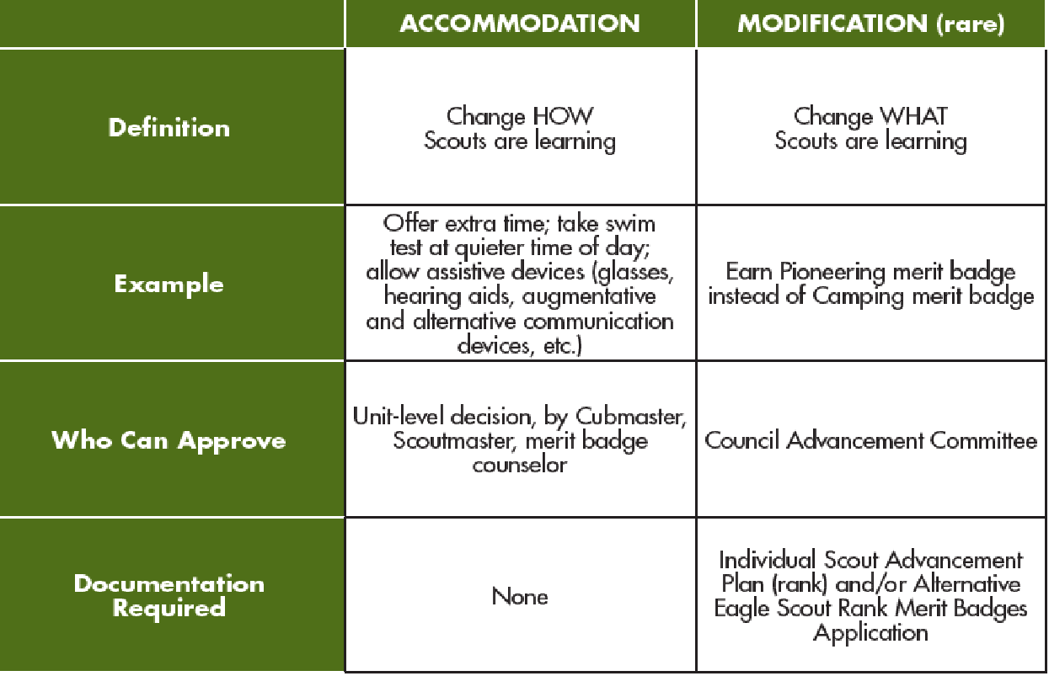
OPEN-MINDED FLEXIBILITY (10.1.2.1.)
Notes:
Emphasize OPEN-MINDED FLEXIBILITY
POINT OUT “HOW” versus “WHAT”, local approval versus council advancement committee
Note the examples for ACCOMMODATION
Mention that standard for Cub Scouts remains DO YOUR BEST
For Scouts BSA, Scout, tenderfoot, Second Class and First Class, may have modification to requirements
No modifications to requirements for Merit Badges, Star, Life, Eagle, or Palms, BUT ACCOMMODATIONS are allowed!
RBAE still applies for significant , long term SND, but note OPEN-MINDED FLEXIBILITY and unit level authority to accommodate requirements
Forms for Alternative Eagle Required Merit Badges, RBAE and ISAP (Section 11.0.0.0) are only first page and indicate 2025 version Those forms are being revised and will be available online soon as 512-935 and 512-936; until then old forms still usable

Slide 12
ONLINE RESOURCES
National Special Needs & Disabilities (SND) Committee website:
https://www.scouting.org/resources/disabilities-awareness/
Email inquiries to the National Committee: specialneedschair@scouting.org
Facebook group: No Scout Left Behind- A Guide to Working with Scouts with SND: https://www.facebook.com/groups/1967878213431320
GGAC SND Committee webpage: https://www.ggacbsa.org/snd
Notes:
QUESTIONS?

